Slide 1
Spring Security

Slide 2
Spring Security was initially known as Acegi Security, but its name
has been changed since joining with the Spring Portfolio projects.
Authentication is the process of verifying a principal’s identity
against what it claims to be.
A principal can be a user, a device, or a system, but most typically, it’s a user.
A principal has to provide evidence of identity to be authenticated. This evidence is called a credential, which is usually a password when the target principal is a user.

Slide 3
Authorization is the process of granting authorities to an authenticated user so that this user is allowed to access particular resources of the target application.
The authorization process must be performed after the authentication process. Typically, authorities are granted in terms of roles.

Slide 4
You have to register a DelegatingFilterProxy instance in the web deployment descriptor, which is a servlet filter that delegates request filtering to a filter in Spring’s application context.
Spring Security allows you to configure web application security through the <http> element.
If your web application’s security requirements are straightforward and typical, you can set this element’s autoconfig
attribute to true so that Spring Security will automatically register and configure several basic security services, including the following in the next slide:

Slide 5
  Form-based login service: This provides a default page that contains a login form for users to log into this application.
  Logout service: This provides a handler mapped with a URL for users to log out of this application.
  HTTP Basic authentication: This can process the Basic authentication credentials presented in HTTP request headers. It can also be used for authenticating requests made with remoting protocols and web services.
  Anonymous login: This assigns a principal and grants authorities to an
  anonymous user so that you can handle an anonymous user like a normal user.
  Remember-me support: This can remember a user’s identity across multiple browser sessions, usually by storing a cookie in the user’s browser.
  Servlet API integration: This allows you to access security information in your webapplication via standard Servlet APIs, such as HttpServletRequest.isUserInRole() and HttpServletRequest.getUserPrincipal().

Slide 6
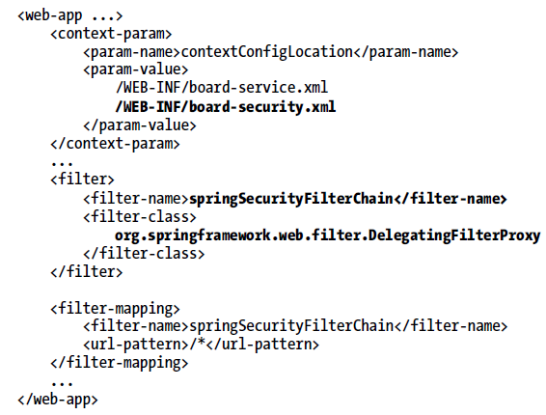
Securing URL Access

Slide 7
The responsibility of DelegatingFilterProxy is simply to delegate HTTP request filtering to a Spring bean that implements the java.util.logging.Filter interface.
By default, it delegates to a bean whose name is the same as its <filter-name> property, but you can override the bean name in its
targetBeanName init parameter.
As Spring Security will automatically configure a filter chain with the name springSecurityFilterChain when you enable web application security, you can simply use this
name for your DelegatingFilterProxy instance.

Slide 8
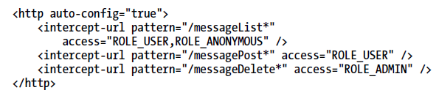
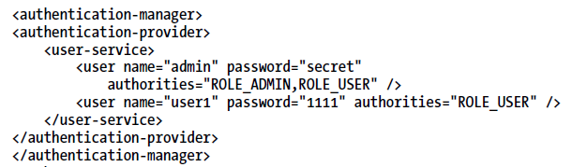

Slide 9
The <http auto-config="true"> element automatically configures the basic security services that a typical web application needs.

Slide 10
Spring Security supports form-based login by providing a default web page that contains a login form.
You can also provide a custom web page as the login page.
Spring Security supports HTTP Basic authentication by processing
the Basic authentication credentials presented in HTTP request headers.

Slide 11
Some parts of your application may allow for anonymous access
Spring Security provides an anonymous login service that can assign a principal and grant authorities to an anonymous user so that you can handle an anonymous user like a normal user when defining
security policies.
Spring Security also supports remember-me login, which is able to remember a user’s identity across multiple browser sessions so that a user needn’t log in again after logging in for the first time.

Slide 12

HTTP Basic Authentication

Slide 13

Form-Based Login
By default, Spring Security automatically creates a login page and maps it to the URL /spring_security_login. So, you can add a link to your application referring to this URL for login:

Slide 14
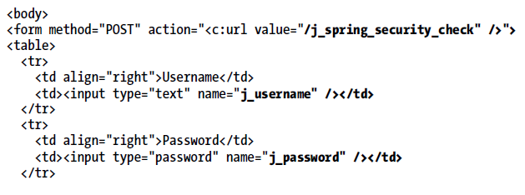
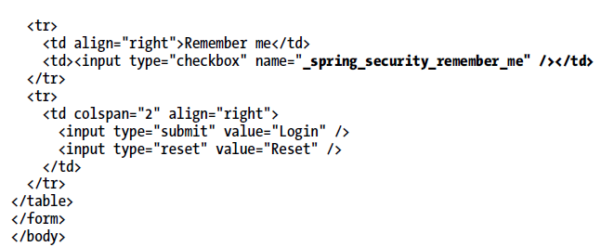
Custom Login Page
If you don’t prefer the default login page, you can provide a custom login page of your own

Slide 15

In order for Spring Security to display your custom login page when a login is requested, you have to specify its URL in the login-page attribute:

Slide 16

If the login page is displayed by Spring Security when a user requests a secure URL, the user will be redirected to the target URL once the login succeeds.
However, if the user requests the login page
directly via its URL, by default the user will be redirected to the context path’s root after a successful login.
If you have not defined a welcome page in your
web deployment descriptor, you may wish to redirect the user to a default target URL when the login succeeds:

Slide 17
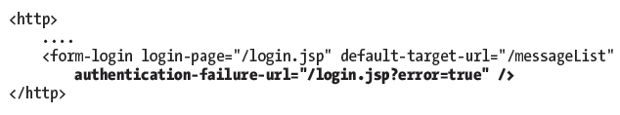
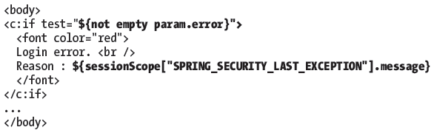
Authentication failure url
Then your login page should test whether the error request parameter is present. If an error has occurred, you will have to display the error message by accessing the session scope attribute
SPRING_SECURITY_LAST_EXCEPTION, which stores the last exception for the current user.

Slide 18
The Logout Service
The logout service provides a handler to handle logout requests. It can be configured via the <logout> element:
<http>
<logout />
</http>
By default, it’s mapped to the URL /j_spring_security_logout, so you can add a link to a page referring to this URL for logout.
<a href="<c:url value="/j_spring_security_logout" />">Logout</a>
This URL can be customized with the logout-url attribute of
<logout>.

Slide 19

By default, a user will be redirected to the context path’s root when the logout succeeds, but sometimes, you may wish to direct the user to another URL, which you can do as follows:

Slide 20
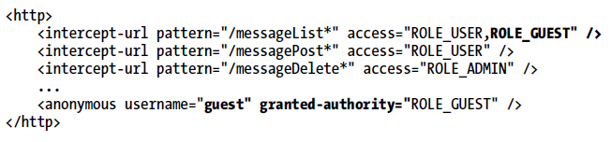
Anonymous Login
The anonymous login service can be configured via the <anonymous> element, where you can customize
the username and authorities of an anonymous user, whose default values are anonymousUser and ROLE_ANONYMOUS:

Slide 21

Remember-Me Support
Remember-me support can be configured via the <remember-me> element.
By default, it encodes the username, password, remember-me expiration time, and a private key as a token, and stores it as a
cookie in the user’s browser. The next time the user accesses the same web application, this token will be detected so that the user can log in automatically.

Slide 22
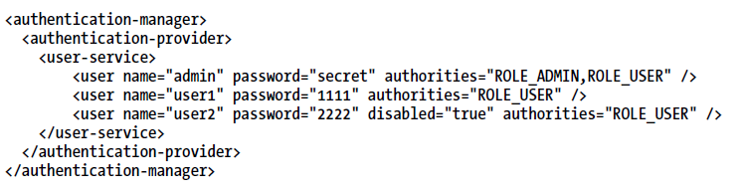
Authenticating Users with In-Memory Definitions

Slide 23
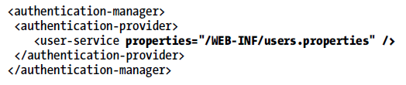

Users.properties
The property key is the username, and the
property value is divided into several parts separated by commas. The first part is the password, and the
second part is the enabled status, which is optional; and the default status is enabled. The following parts are the authorities granted to the user.

Slide 24
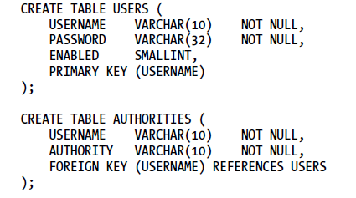
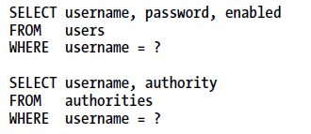
Authenticating against database

Slide 25
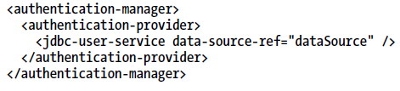

Slide 26
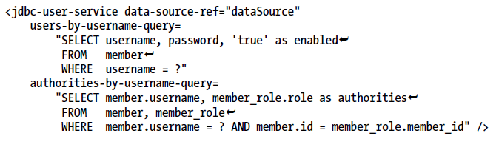

Slide 27
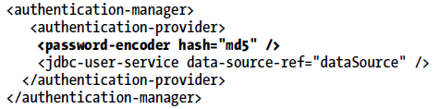
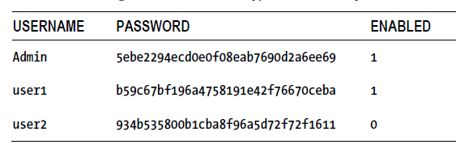
Encrypting Passwords
you have to store the encrypted passwords in the database tables, instead of the clear-text passwords,

Slide 28
MAKING ACCESS CONTROL DECISIONS

Slide 29
In the authentication process, an application will grant a successfully authenticated user a set ofauthorities.
When this user attempts to access a resource in the application, the application has to decide whether the resource is accessible with the granted authorities .
The decision on whether a user is allowed to access a resource in an application is called an access control decision.
In Spring Security, access control decisions are made by access decision managers, which have to implement the AccessDecisionManager interface.

Slide 30
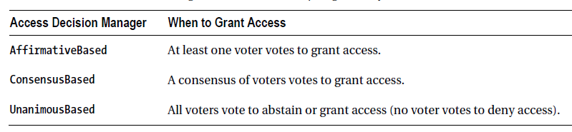
All these access decision managers require a group of voters to be configured for voting on access control decisions.
Each voter has to implement the AccessDecisionVoter interface.
A voter can vote to grant, abstain, or deny access to a resource. The voting results are represented by the ACCESS_GRANTED, ACCESS_DENIED, and ACCESS_ABSTAIN constant fields defined in the AccessDecisionVoter interface.

Slide 31
By default, if no access decision manager is specified explicitly, Spring Security will automatically configure an AffirmativeBased access decision manager with the followaing two voters configured:
  RoleVoter
  AuthenticatedVoter

Slide 32
RoleVoter
RoleVoter votes for an access control decision based on a user’s role.
It will only process accessattributes that start with the ROLE_ prefix, but this prefix can be customized.
It votes to grant access if the user has the same role as required to access the resource or to deny access if the user lacks any role
required to access the resource.
If the resource does not have an access attribute starting with ROLE_, it will abstain from voting

Slide 33
AuthencaticatedVoter
AuthenticatedVoter votes for an access control decision based on a user’s authentication level.
It will only process the access attributes IS_AUTHENTICATED_FULLY, IS_AUTHENTICATED_REMEMBERED, and
IS_AUTHENTICATED_ANONYMOUSLY.
It votes to grant access if the user’s authentication level is higher than the required attribute.
From highest to lowest, authentication levels are fully authenticated,
authentication remembered, and anonymously authenticated.

Slide 34
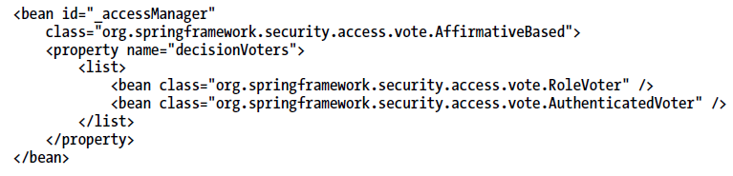
By default, Spring Security will automatically configure an access decision manager if none is specified.
This default access decision manager is equivalent to the one defined with the following bean configuration:

Slide 35
Securing Method Invocations
you can embed a <security:intercept-methods> element in a bean definition to secure its methods.
Alternatively, you can configure a global <global-method-security> element to secure multiple methods matched with AspectJ
pointcut expressions.
You can also annotate methods declared in a bean interface or an implementation class with the @Secured annotation and then enable security for them in <global-method-security>.

Slide 36
Securing Methods by Embedding a Security Interceptor
<bean id="messageBoardService"
class="com.training.MessageServiceImpl">
<security:intercept-methods
access-decision-manager-ref="accessDecisionManager">
<security:protect
method="com.training.MessageService.listMessages"
access="ROLE_USER,ROLE_GUEST" />
<security:protect
method="com.training.MessageService.postMessage"
access="ROLE_USER" />
<security:protect
method="com.training.MessageService.deleteMessage"
access="ROLE_ADMIN,IP_LOCAL_HOST" />
<security:protect
method="com.training.MessageService.findMessageById"
access="ROLE_USER,ROLE_GUEST" />
</security:intercept-methods>
</bean>

Slide 37
Securing Methods with Pointcuts
<global-method-security
access-decision-manager-ref="accessDecisionManager">
<protect-pointcut expression=
"execution(* com.training.*Service.list*(..))"
access="ROLE_USER,ROLE_GUEST" />
<protect-pointcut expression=
"execution(* com.training.*Service.post*(..))"
access="ROLE_USER" />
<protect-pointcut expression=
"execution(* com.training.*Service.delete*(..))"
access="ROLE_ADMIN,IP_LOCAL_HOST" />
</global-method-security>

Slide 38
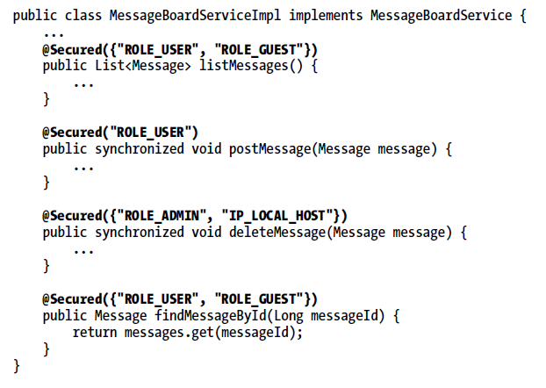

Securing Methods with Annotations

Slide 39
HANDLING SECURITY IN VIEWS

Slide 40
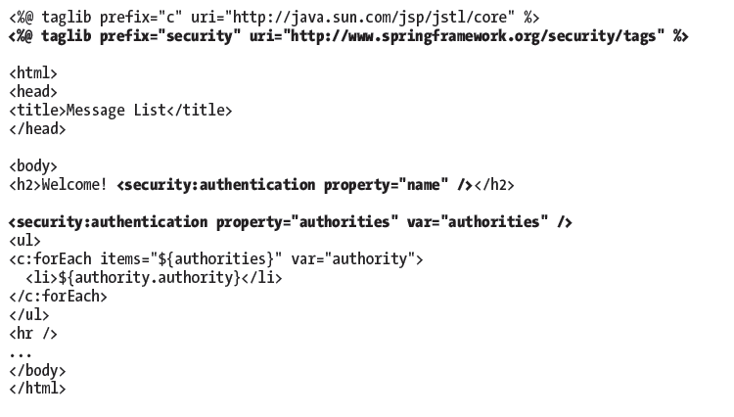
Displaying Authentication Information

Slide 41
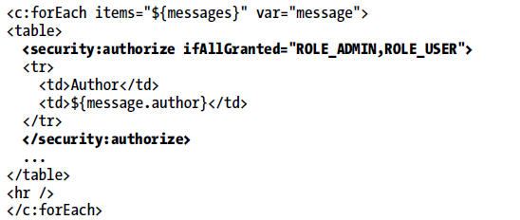
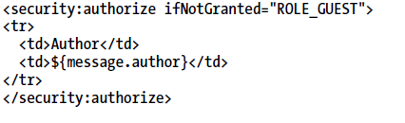
Rendering View Contents Conditionally

